Slide 1

Design and Simulation of an Intelligent Traffic Signal Decision System Using Combinational Logic
Nivedhitha — 2620030175
Kusuma — 2620030511
Saanvi— 2620090044
Navadeep — 2620030508
Yuvaraj — 2620030680
Faculty Guide: Dr. B. Srinivas

Slide 2


2 · INTRODUCTION AND OBJECTIVE
Fixed-time signals waste green time; combinational logic can decide from live density
Traffic congestion grows when signal timing ignores which lane is actually busy. A fixed-time cycle gives the same green to an empty lane and a crowded one.
Element | Meaning in this project
Traffic-density inputs | Each lane reports 1 = high density or 0 = low density
Combinational logic | Output depends only on current inputs, with no memory
Decision outputs | Signal decision for the selected lane
Objective | Design, build in Logisim, and verify the decision logic

Slide 3
3 · THEORY AND LOGIC CIRCUIT
Two lane inputs feed one OR gate that requests green for a dense lane
Inputs: A and B, where 1 = high density and 0 = low density
A | B | Y = A + B
0 | 0 | 0
0 | 1 | 1
1 | 0 | 1
1 | 1 | 1
Gate | Rule | Use
AND | Y = 1 only if both inputs are 1 | Both lanes dense
OR | Y = 1 if any input is 1 | Any lane dense
NOT | Inverts one input | Complement
Labelled OR-gate circuit: A → [OR] → Y, B → [OR]. Y = 1 when either lane is dense.
Expression: Y = A + B
Detection vs lane selection: sensors detect density physically; the logic circuit selects which lane receives the green request.

Slide 4
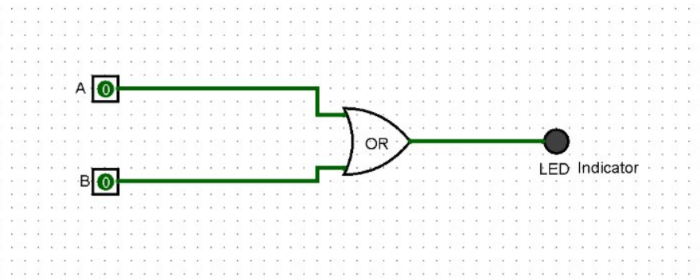

4 · CIRCUIT DESIGN IN LOGISIM
Build the OR decision circuit: two switches, one gate, one indicator
Component | Connection
Input switch A | → OR gate input 1
Input switch B | → OR gate input 2
OR gate | output → Y indicator (LED)
[
Place pins A and B as input switches.
Place an OR gate and wire A and B to its inputs.
Place an LED and wire it to the OR output, labelled Y.
Toggle A and B to check Y against the truth table.

Slide 5

5 · SIMULATION RESULTS
Full truth table: expected outputs set against observed Logisim outputs
A | B | Expected Y | Observed Y (Logisim)
0 | 0 | 0 | OFF
0 | 1 | 1 | ON
1 | 0 | 1 | ON
1 | 1 | 1 | ON
]
Verification status: pending. Observed values are recorded only from the actual Logisim run; no results are claimed here.

Slide 6

6 · CONCLUSION AND APPLICATIONS
Combinational logic makes the lane-density decision; timed control comes next
The project shows how an OR decision circuit turns binary density inputs into a lane request, built and tested in Logisim.
Learning outcomes: binary inputs, gates, truth tables, Logisim construction
Educational uses: teaching combinational design and verification
Future improvements: density sensors, multi-lane logic, timed control
Limitation: a complete timed controller needs sequential logic, timers, safety mechanisms, and possibly a processor-based extension.
Thank You
06

